Slide 1
Introduction to Big Data
Introduction to Big-Data Analysis

Slide 2

Case Study: Royal Manufacturing
Emily Johnson
(CTO at Royal Manufacturing)
Company Background:
Royal Manufacturing is an engine manufacturing company, renowned for its advanced solutions and products of aircraft engines.
Company utilizes engine performance data captured during flights for their analysis and performance improvement. This data is analyzed after the flight with recorded readings of 100 parameters.
They generates 3 petabytes of data while producing 6000 turbine fan blades annually.

Slide 3

Case Study: Royal Manufacturing
Emily Johnson
(CTO at Royal Manufacturing)
Current Situation & Challenges:
Despite having large amount of data for monitoring, Royal manufacturing's analytics teams is only able to analyze the data after the flight.
With technical advancement in industry there are so much possibilities of mapping large numbers of parameters.
They are also facing lag/ delay between data capturing and analysis process.

Slide 4

Case Study: Royal Manufacturing
Emily Johnson
(CTO at Royal Manufacturing)
Understanding the pressing need for a solution, Emily Johnson CTO Of Royal Manufacturing, decided to implement Big-data Solutions to address these challenges.
The Solution – Big-data Analysis :
Emily led a series of educational workshops to familiarize analytical teams with the benefits and application of Big Data Analysis.
The integration of bigdata infrastructure and solution helped them to capture more than 5000 parameters and process it efficiently.
Their data capturing devices are always connected with cloud monitoring databases. Which enables them to capture live data 24*7.

Slide 5

Case Study: Royal Manufacturing
Emily Johnson
(CTO at Royal Manufacturing)
The Result:
The incorporation of Big Data the next generation of engines will monitor more than 5,000 parameters and will always be connected to the cloud monitoring solution, in order to prevent issues before they occur.

Slide 6
This emphasizes the importance of Big Data Analytics for organizations across segments.
Let's study more about Big-Data Analytics in this Module

Slide 7
Module Coverage
Definition of Big Data
Understanding Big Data
The 5 Vs of Big Data
How big data is generated
Introduction to Big Data Analysis
Definition of Big Data Analysis
Importance and benefits of Big Data Analysis
Behavior Analysis in E-commerce
Big Data Technologies
Popular Big Data technologies
Example of how these technologies are used
Big Data Analysis Process
Definition of Big Data Analysis Process
Use case of Data Analysis Process
Challenges in Big Data Analysis & Future
Challenges in Big Data Analysis
Example of Data Analysis Process
Future Trends in Big Data Analysis
Summary
Key Points to remember
Activity
References

Slide 8
Definition of Big Data
Definition of Big Data
5 V's of Big Data
Real example of how big data is generated

Slide 9
Big data refers to vast and complex datasets that traditional data processing tools cannot easily handle. It encompasses high volume, high velocity, and a variety of data, requiring advanced tools and methods for analysis and processing.
What is Big-Data?

Slide 10
Big Data Facts-How Big is Big Data
Twitter users send out
More than
285,000
100 MILLION
Tweets
New emails are generated
Facebook processes almost
72 HOURS
350GB
of new video are uploaded to you tube
of data
Individuals and organizations launch
Walmart processes almost
576
15,000
New websites
Transactions
Google processes more than
Sprint processes more than
2 MILLION
300,000
Search queries
Phone calls

Slide 11
How Big is Big Data
Number Of Emails Sent Every Second
Data consumed by households each day
Data per day processed by google
Total minutes spent on facebook each month
Data sent and received by mobile internet users
Products ordered on amazon per second
Video upload to youtube every minute
Tweets per
day
2.9 Million
375 Megabytes
20 Hours
24 Petabytes
50 Million
700 Billion
1.3 Exabytes
72.9 Items

Slide 12
Small Data Vs Big Data
SMALL DATA
BIG DATA
Low volumes
Batch velocities
Structured varieties
Into petabyte volumes
Real-time velocities
Multistructured varieties

Slide 13
The 5 Vs of Big Data
Volume
Big data involves vast amounts of information, often measured in terabytes, petabytes, or beyond, originating from multiple sources such as social media, sensor networks, and financial transactions.
Velocity
The data is generated at high speeds and in real-time, requiring rapid processing for timely insights and decisions.
Big data
Variety
It comprises diverse data types, including structured, semi-structured, and unstructured data like text, images, videos, and more.
Veracity
The quality and reliability of big data can vary significantly due to its volume and diverse sources, making data accuracy and trustworthiness crucial.
Value
The ultimate purpose of big data is to extract valuable insights and actionable information, enabling data-driven decision-making, process optimization, and gaining a competitive advantage.

Slide 14

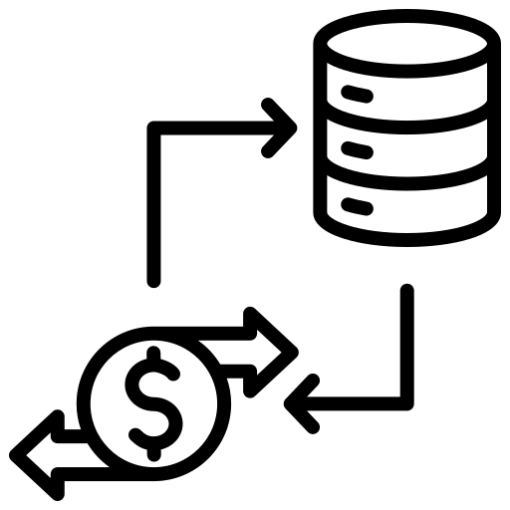
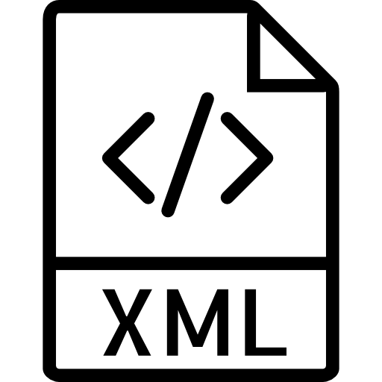




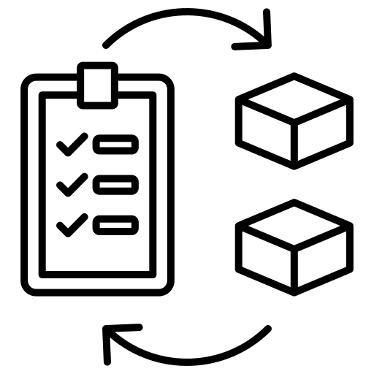




Forms/Type of Big Data
Unstructured
Structured
Semi-Structured
Between the tow forms where “tags” or “structure” are associated or embedded within unstructured data.
Data that does not reside in fixed locations generally refers to free-form text, which is ubiquitous.
Data that resides in fixed fields within a record or file.
Social Media Posts
Sales Transactions
XML Documents
Video Surveillance Footage
Employee Payroll Records
JSON Files
Audio Recordings
Inventory Databases
Log Files
Images and Photos
Customer Contact Lists
NoSQL Databases

Slide 15

Example of Big Data
Social Media
Interaction:
Social media platforms like Facebook, Twitter, Instagram, and LinkedIn gather massive amounts of data through user interactions.
Each time a user posts a status, shares a photo, writes a comment, likes a post, follows a profile, or sends a message, data is generated and stored.
Content Sharing:
When users upload photos, videos, and other media files, each piece of content adds to the growing pool of big data.
The frequency and volume of content sharing contribute significantly to the generation of big data on these platforms. On that Ad Interactions, Social Graph, Sentiment Analysis and Location Data.

Slide 16

Data examples from social media
Text Data: Posts, comments, tweets, and messages, including status updates, reviews.
Images: Photos and visual content uploaded by users.
Videos: Video content shared on social media platforms.
User Profiles: Demographic data, interests, and preferences collected from user profiles.
Location Data: Geotagged information, revealing user locations.
Engagement Metrics: Likes, shares, comments, retweets, and reactions used to measure content performance.
Social Network Data: Information on user connections and interactions, forming social network graphs.
Hashtags and Keywords: Tracking popular trends and brand mentions.
Sentiment Data: Analyzing user sentiment towards topics, brands, or events.
Time-Series Data: Timestamped data for trend analysis and event impact assessment.

Slide 17

Example of Big Data
IoT devices
IoT devices, like smart appliances, wearable devices, and industrial sensors, continuously collect data through embedded sensors.
This data is transmitted to centralized servers or the cloud using various communication technologies.
Once in the cloud, big data analytics techniques process and analyze the data to derive valuable insights.
These insights can be applied to improve efficiency, optimize processes, enhance user experiences, and enable data-driven decision-making in various domains, such as smart cities and healthcare.
Overall, IoT devices are a significant source of big data, generating massive amounts of information that can be harnessed for numerous practical applications in our interconnected world.

Slide 18

Data examples from IoT devices
Temperature & Humidity: Smart thermostats and weather sensors collect climate data.
GPS Location: Smartphones and wearables provide real-time location information.
Health & Biometric Data: Fitness trackers capture biometrics like heart rate and sleep patterns.
Energy Consumption: Smart meters monitor electricity, gas, and water usage.
Vehicle Telemetry: IoT devices in automobiles track vehicle performance.
Environmental Data: Agriculture sensors measure soil moisture and air quality.
Industrial Sensors: Devices in industries monitor equipment performance.
Home Automation Data: Smart home devices control lighting and security.
Security Data: Surveillance cameras offer real-time video data.
Retail Analytics: Devices in stores track customer foot traffic and interactions.
Wearable Health Devices: Medical IoT devices gather health data.
Air Quality Monitoring: Urban sensors measure air pollutants.
Smart Grid Data: Devices in power grids monitor energy flow.
Smart Appliances: Household devices offer personalized settings.

Slide 19

Example of Big Data
Banking
Banking institutions handle an enormous number of financial transactions every day. These include credit card transactions, debit card payments, fund transfers, ATM withdrawals, deposits, and more.
Each transaction generates data related to the customer, the amount, date, time, location, and other relevant details.
Banks maintain extensive customer databases containing personal information, account details, credit scores, transaction history, and more.
This data is used for customer profiling, targeted marketing, and personalized services.
These shows how big data is being used to drive decision-making, improve operations, and enhance the customer experience in the banking domain.

Slide 20

Data Examples from Banking Domain
Transaction Data: Records of deposits, withdrawals, transfers, and purchases.
Customer Information: Personal data like name, address, contact details.
Account Balances: Current balances and transaction history.
Credit History: Information on credit usage and repayment patterns.
Loan Data: Details of granted loans, including amounts and terms.
Investment Data: Customer investment portfolios, e.g., stocks, bonds.
Risk Data: Credit, market, and operational risk information.
Fraud Data: Information on potentially fraudulent activities.
Customer Segmentation: Data categorizing customers for personalized services.
Regulatory Compliance Data: Information on compliance with regulations.
ATM and POS Data: Information from cash machines and point-of-sale terminals.
Customer Feedback: Feedback from surveys and reviews.

Slide 21

Quiz
What is the primary characteristic of Big Data?
Small Volume
Structured Format
Low Velocity
Massive quantity
Answer: D
Explanation:
The primary characteristic of Big Data is its massive volume. Big Data refers to datasets that are too large and complex for traditional data processing applications to handle efficiently. It involves vast amounts of data generated from various sources, such as social media, sensors, and transaction records. The sheer volume of data necessitates specialized tools and techniques for storage, processing, and analysis.

Slide 22
Quiz
What is the goal of Big Data analytics?
To store and manage large volumes of data efficiently.
To analyze data to gain valuable insights and make informed decisions.
To develop complex algorithms for data processing.
To create visually appealing dashboards for data representation.
Answer: B
Explanation:
the primary goal of Big Data analytics is to analyze large volumes of data to extract valuable insights and patterns, enabling informed decisions and driving business improvements. It involves using advanced tools to process and interpret data efficiently, helping organizations identify opportunities, detect risks, enhance customer experiences, optimize processes, and improve overall performance.

Slide 23
In a nutshell, we learnt
Big data refers to extremely large and complex data sets that surpass the capabilities of traditional data processing methods.
There are 5 Vs of Big Data: Volume, Velocity, Variety, Veracity, and Value
Big data is generated across multiple domains: banking, IoT devices, e-commerce, and social media. Often transactional data and user interaction data are huge in volume and are termed as big data.

Slide 24
Introduction to Big Data Analysis
Definition of Big Data Analysis
Importance and benefits of Big Data Analysis
Behavior Analysis in E-commerce

Slide 25
Big data analysis is the process of applying advanced analytics techniques to large and diverse datasets to extract valuable insights, patterns, and trends that enable data-driven decision-making and optimize business processes.
What is Big-Data Analysis ?

Slide 26


Importance and benefits of Big Data Analysis
Data-Driven Decisions
Uncover Trends in live data
Improved Efficiency
Enhanced Customer Experience
Competitive Advantage
Notes:
Data-Driven Decisions: Big Data Analysis allows businesses to make decisions based on actual data, rather than hunches or estimates.
Uncover Trends in live data: It helps to identify hidden patterns and trends in vast amounts of data, which can provide valuable business insights in live databases.
Improved Efficiency: Big Data Analysis can optimize analysis operations by their distributed operation approach, streamline processes leading to improved operational efficiency.
Enhanced Customer Experience: By analyzing large amount of customer data, businesses can tailor experiences, products, and services to individual needs, enhancing customer satisfaction and loyalty.
Competitive Advantage: Businesses that leverage Big Data Analysis can gain an edge over competitors by acting on insights that others may not be aware of.

Slide 27

Use case - Customer Behavior Analysis E-commerce
E-commerce heavily relies on big data analysis to comprehend customer behavior and preferences. By delving into vast datasets encompassing browsing history, purchase patterns, and demographics, e-commerce companies can extract invaluable insights.
This analysis yields several significant benefits
Increased Engagement: Through personalized recommendations, customers encounter items that align with their interests, thereby stimulating higher interaction with the platform and encouraging them to explore more products.
Higher Conversion Rates: The provision of personalized recommendations fosters a sense of being understood among users, resulting in elevated conversion rates as they are more inclined to purchase products tailored precisely to their preferences
Improved Satisfaction: Users experience greater satisfaction during their shopping journeys as they spend less time searching for products and more time discovering items that perfectly match their interests.

Slide 28
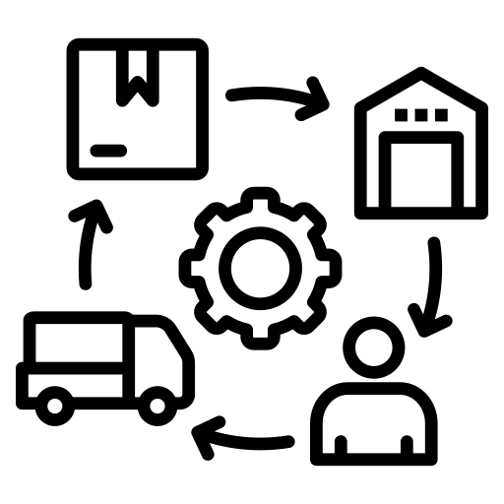
Use case- Supply Chain Optimization
Current Scenario
Efficient supply chain management can significantly impact success. The company faced difficulties with managing inventory, recurrent stockouts, suboptimal transportation routes, and operational inefficiencies that adversely affected their profit margin and customer satisfaction.
Solution
The company embraced Big Data Analysis to evaluate various data, including sales statistics, stock levels, logistics information, and external variables like weather and demand variations.
This data-centric approach enabled proficient inventory management, reduced stockouts through demand forecasting, optimized transport routes, and enhanced operational efficiency.
Impact
The supply chain's operational efficiency saw a substantial improvement, leading to cost reduction and waste minimization. This optimization also enhanced the overall customer experience by ensuring products were readily available according to customer needs.

Slide 29
Quiz
How does the Big Data Analysis is utilized in understanding customer behavior and preferences ?
By enabling real-time analysis of customer interactions and feedback.
By offering personalized product recommendations based on historical data.
Identifying patterns and trends in customer behavior from large datasets.
Automating customer service interactions using AI algorithms.
All Of the Above
Answer: E
Explanation:
Big Data Analysis is crucial for understanding customer behavior and preferences. It enables real-time analysis of customer interactions and feedback, offers personalized product recommendations based on historical data, identifies patterns and trends from large datasets, and automates customer service interactions using AI algorithms. This valuable insight helps improve products, enhance experiences, and drive business growth.

Slide 30
Quiz
What are the importance and benefits of Big Data Analysis?
Improved decision-making, enhanced customer experiences, and reduced operational costs.
Slower data processing, increased data complexity, and higher infrastructure costs.
Limited scalability, decreased data insights, and reduced business agility.
No significant impact on businesses, outdated technology, and increased data security risks.
Answer: A
Explanation:
Big Data Analysis refers to the process of analyzing and extracting valuable insights from large and complex datasets. The importance and benefits of Big Data Analysis are immense

Slide 31
In a nutshell, we learnt
Big Data Analysis involves examining large datasets to extract valuable insights for informed decision-making.
Its importance lies in gaining deeper insights into customer behavior, market trends, and operational efficiency, enabling data-driven decision-making, personalized services, and improved business strategies.
In e-commerce, behavior analysis analyzes customer interactions to understand consumer behavior, optimize user experiences, and enhance targeted marketing efforts.

Slide 32
Big Data Technologies
Popular Big Data technologies for data process, data storage, data analytics and visualization.
Example of how these technologies are used

Slide 33

Big Data Tools
Big data tools are technologies which enable processing, storage and analysis of big data.
Often big data tools used distributed computing (Hadoop, Spark), Distributed Storage (HDFS, Hbase, Delta Lake), Distributed ingestion (Kafka, flume).
Hadoop Components (HDFS, MapReduce, yarn, HIVE, pig, mahout), Spark components(Spark Dataframe, Spark SQL, Spark ML, Spark Streaming) and Kafka are popular big data tools.

Slide 34


Big Data Tools
Big Data Ingestion
Big Data Storage
Big Data Processing
Big Data Analytics
Big Data Visualization
Apache Kafka
Apache Flume
Sqoop
HDFS
Cassandra
MongoDB
Hbase
Apache Spark
MapReduce,
Apache Flink
Apache Beam
Apache Hive
Apache Pig
Tableau
Power BI
Grafana

Slide 35



Technologies For Big Data Ingestion
A distributed streaming platform that is used to build real-time data pipelines and streaming applications. Kafka is commonly used for handling high-throughput, real-time data streams.
Flume is a powerful and dependable software designed to efficiently gather, consolidate, and transport substantial volumes of log data in a distributed manner. providing a straightforward and adaptable solution for handling log data.
Apache Sqoop is a specialized tool crafted to facilitate the smooth and efficient movement of large datasets between Apache Hadoop and structured data storage systems, such as relational databases

Slide 36




Technologies For Big Data Storage
Hadoop open-source framework that allows distributed processing of large datasets across clusters of computers. It uses Hadoop Distributed File System (HDFS) for storage.
A distributed and decentralized database system designed for high availability and fault tolerance.
MongoDB is a popular NoSQL database system that stores data in a flexible, document-oriented format. It is designed to handle large volumes of data and is known for its scalability, high performance, and ease of use.
HBase is an open-source, distributed, and scalable NoSQL database built on top of the HDFS. It provides real-time read and write access to large volumes of data and is designed to handle massive amounts of data with high throughput and low latency.

Slide 37




Technologies For Big Data Processing
Open-source data processing engine that works with big data in memory. Spark is known for its speed and supports real-time data processing, machine learning, graph processing, and more.
MapReduce is a distributed programming model used for processing large datasets in parallel. It divides data processing into "map" and "reduce" phases, enabling efficient and scalable data analysis across multiple computers.
Apache Flink is distributed stream processing framework designed to process real-time data streams and batch data with low-latency and high-throughput. It provides advanced data processing capabilities, including event time processing, windowing, and stateful computations.
Apache Beam is versatile data processing framework that unifies batch and streaming data processing with a consistent API. It enables developers to create data pipelines that run on multiple distributed processing engines and efficient data analysis across diverse environments in big data applications.

Slide 38


Technologies For Big Data Analytics
A data warehousing and SQL-like query language built on top of Hadoop, used for data summarization, ad-hoc querying, and analysis.
Apache Pig is a powerful platform for analyzing large datasets, providing a high-level language and efficient infrastructure for parallel processing, making it capable of handling massive amounts of data with ease

Slide 39



Technologies For Big Data Visualization
Tableau is a popular data visualization and business intelligence tool that enables users to create interactive and visually appealing dashboards, reports, and charts.
Power BI is a widely used business analytics service enabling interactive data visualization and powerful business intelligence capabilities. Users can create captivating reports and dashboards, gaining valuable insights from diverse data sources and facilitating informed decision-making through easy sharing and comprehensive analysis.
Grafana is an open-source data visualization and monitoring tool widely used to create interactive dashboards for analyzing and displaying metrics and time-series data from diverse sources. it facilitates real-time monitoring and data exploration across different industries.

Slide 40

How Yahoo utilise Hadoop
Yahoo, a global technology company, manages extensive user data from services such as search, email, news, and advertising. To handle this massive data efficiently.
Here's how Yahoo utilized Hadoop:
Data Storage: Yahoo used Hadoop's Hadoop Distributed File System (HDFS) to store petabytes of data across a cluster of commodity servers. HDFS allows for data replication, ensuring data redundancy and fault tolerance.
Data Processing: Yahoo employed Hadoop's MapReduce programming model to process and analyze the stored data. MapReduce enables parallel processing of data across multiple nodes in the Hadoop cluster, making it possible to crunch vast datasets quickly.

Slide 41

Yahoo utilise Hadoop
Data Analysis:
Hadoop's ability to handle unstructured data allowed Yahoo to perform in-depth analysis of user behavior, preferences, and interactions with their services. This data analysis provided valuable insights for improving their products, personalizing user experiences, and optimizing advertising strategies.
Scalability:
As Yahoo's data continued to grow, Hadoop's scalability allowed them to add more nodes to the cluster seamlessly, accommodating the increasing data volume without disruptions.

Slide 42
Quiz
What is the primary function of Apache Kafka in Big Data Technologies?
Data storage
Data processing
Data visualization
Data streaming
Answer: D
Explanation:
Apache Kafka is a distributed streaming platform designed for real-time data streaming and messaging. It acts as a messaging system that efficiently handles data streams, enabling high-throughput and low-latency data processing in real-time.

Slide 43
Quiz
Which technology is commonly used for distributed storage and processing of large datasets
in Big Data applications?
SQL Server
Hadoop
Microsoft Excel
Oracle
Answer: B
Explanation:
Hadoop is a widely used technology in the Big Data domain for distributed storage and processing of large datasets. It is an open-source framework that allows the processing of massive amounts of data across clusters of commodity hardware.

Slide 44
In a nutshell, we learnt
well-known high-level big data technologies such as Hadoop: an open-source framework that allows distributed processing of large datasets across clusters of computers.
Kafka: A distributed streaming platform that is used to real-time data streams.
The practical application of these technologies in real-world scenarios, showcasing their efficiency in handling massive datasets.

Slide 45
Big Data Analysis Process
Definition of Big Data Analysis Process
Example of Data Analysis Process

Slide 46
Big data analytics involves extracting trends, patterns, and correlations from vast amounts of raw data to facilitate data-driven decision-making. This approach applies traditional statistical analysis techniques such as clustering and regression but leverages modern tools to handle and process larger datasets effectively.
What is Big Data Analysis Process?

Slide 47
Big Data Analysis Process
Data Receiving
Data Pre-processing
Data Integration
Data Preparation
Data Analytics
Result Publishing
Data Storage
This slide is 100% editable. Adapt it to your needs and capture your audience's attention.

Slide 48

Example of Big Data Analysis Process
Predictive Maintenance in Wind Turbines
Predictive maintenance optimizes maintenance in wind turbines using big data analysis.
Data Collection
Sensors monitor critical, generating real-time data (e.g., wind speed, temperature). parameters
Data Preprocessing
Raw data is cleaned and processed for analysis.
Advanced algorithms identify patterns and correlations
Data Analytics
Early signs of issues (vibration changes, irregular readings) are detected.
Predictive Models
Machine learning predicts likelihood of future failures.
Pattern Recognition

Slide 49
Insights from Big Data Analysis Process
Anomaly Detection
Maintenance Scheduling
Condition-Based Maintenance
Real-time monitoring triggers maintenance alerts.
Proactive maintenance reduces unscheduled downtime.
Components replaced when needed, cutting costs.

Slide 50

Impact of Big Data Analysis Process
Optimized Operations
Efficient energy production
Benefits
Cost savings
Increased reliability
Improved efficiency
Enhanced safety.

Slide 51
Quiz
What is the main advantage of Big Data Analysis?
It guarantees 100% accurate results.
It allows for the analysis of small, structured datasets.
It enables organizations to make data-driven decisions based on insights from vast and diverse datasets.
It eliminates the need for data storage.
Answer: C
Explanation: The main advantage of Big Data Analysis is that it allows organizations to gain valuable insights from large and diverse datasets. By analyzing vast amounts of data, businesses can make data-driven decisions, identify trends, discover patterns, and gain a deeper understanding of their operations and customer behavior. However, it's essential to note that while Big Data Analysis provides valuable insights, it does not guarantee 100% accuracy, and data quality and the right analytical approach remain crucial for drawing meaningful conclusions

Slide 52
Quiz
What is the correct sequence of steps in the Big Data Analysis process?
Data Collection -> Data Visualization -> Data Cleaning -> Data Modeling -> Insights Extraction
Data Cleaning -> Data Visualization -> Data Collection -> Insights Extraction -> Data Modeling
Data Collection -> Data Cleaning -> Data Modeling -> Data Visualization -> Insights Extraction
Data Modeling -> Data Cleaning -> Data Visualization -> Data Collection -> Insights Extraction
Answer: C
Explanation: (Data Collection -> Data Cleaning -> Data Modeling -> Data Visualization -> Insights Extraction) represents the correct sequence of steps in the Big Data Analysis process, ensuring a systematic approach to derive valuable insights from vast and complex datasets.

Slide 53
In nutshell, we learnt
Definition of big data analysis process and how it’s working
Example of data analysis process: in a wind turbines the data analysis process involves collecting data, information, and performing analysis, optimization to improve operational efficiency.

Slide 54
Challenges in Big Data Analysis & Future
Challenges in Big Data Analysis
Example of Data Analysis Process
Future Trends in Big Data Analysis

Slide 55

Challenges in Big Data Analysis
Big Data Analytics helps organizations get right insights to take intelligent and informed decisions. But as it uses data from business, it bring multiple challenges with it as well.

Slide 56




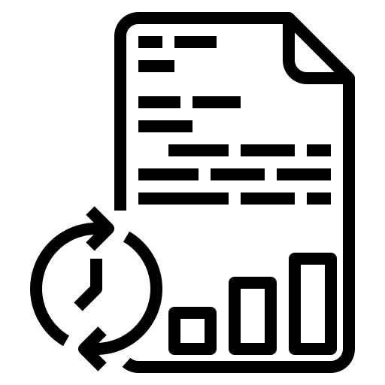

Challenges in Big Data Analysis:
Data Privacy, Security, and Compliance
Data Quality, Variety, and Integration
Infrastructure and Scalability
Real-Time Analysis and Data Processing Speed
Ethics and Bias in Data
Notes:
Data Privacy, Security, and Compliance: Ensuring the privacy and security of large datasets is a key challenge, especially when data is dispersed across multiple locations.
Data Quality, Variety, and Integration: Big data comes in many forms and structures. Ensuring the quality of this diverse data and integrating it can be complex.
It's also challenging to manage structured, semi-structured, and unstructured data effectively.
Infrastructure and Scalability: Big data processing requires robust computing power and storage.
Expanding infrastructure to accommodate increasing data volumes is both expensive and technologically demanding.
Real-Time Analysis and Data Processing Speed: For certain applications, real-time analysis is necessary. Managing real-time data and analytics adds complexity.
Ethics and Bias in Data: Big data analysis could lead to biased results if the data used reflects societal biases or lacks diversity.
Addressing these ethical issues is critical to ensure fair decision-making.

Slide 57

Challenges and Solutions-Twitter
Challenge: Twitter faced the challenge of analyzing and processing an enormous stream of real-time data generated by millions of users.
Traditional relational databases and single-server solutions were insufficient to handle the scale and complexity of the data in a timely manner. The company needed a system that could process, analyze, and extract insights from a continuous stream of tweets, which could potentially reach thousands of tweets per second.
Solution: Twitter overcame this challenge by adopting Apache Storm, a distributed real-time computation system. Apache Storm allows the processing of streaming data in a fault-tolerant and scalable manner.
Instead of relying on a single server, Apache Storm distributes the computational load across a cluster of machines, enabling horizontal scalability and high throughput.

Slide 58

Challenges and Solutions-Twitter
Here's how Apache Storm helped Twitter with real-time analytics:
Distributed Architecture: Enables parallel processing across multiple worker nodes, optimizing resource utilization and speeding up data analysis.
Fault Tolerance: Built-in mechanism ensures processing continues on available nodes if a cluster node fails, maintaining system reliability for massive data streams.
Scalability: Easily scales the cluster by adding more worker nodes to handle increasing data volumes without compromising performance.
Real-time Insights: Low-latency processing allows Twitter to derive real-time insights from tweet streams, enabling trend monitoring and quick response to critical events.
Extensibility: Supports multiple programming languages, giving Twitter developers flexibility in writing data processing logic.

Slide 59

Future Trends in Big Data Analysis
Real-time Analysis:
With the increasing demand for instant insights to drive quick decision-making, real-time data analysis is set to rise. Technologies like Apache Kafka, Apache Flink, and stream processing frameworks are getting widely adopted to support real-time analytics.
AI and Machine Learning Integration:
Artificial intelligence and machine learning are becoming integral parts of big data. They help in predicting patterns, automating data management, optimizing resources, and improving the accuracy of results. Machine learning algorithms can learn from data over time, improving their performance and enabling more sophisticated analysis.

Slide 60


Future Trends in Big Data Analysis
Edge Computing:
To reduce latency and speed up data processing, edge computing is becoming more prominent. It allows data to be processed closer to its source, reducing the need for data to travel to a centralized location.
Data Fabric:
Data Fabric architecture uses existing metadata to provide a unified and consistent data access and delivery across a wide array of data sources and types.
Quantum Computing:
Quantum computers have the potential to process complex datasets much faster than traditional computers. As quantum computing technology matures, it could revolutionize big data processing, solving complex problems in seconds that currently take days or weeks to compute.

Slide 61
Quiz
Which technology is expected to revolutionize data storage in Big Data Analysis?
Cloud Computing
Traditional databases
Magnetic tapes
Optical disks
Answer: A
Explanation:
Cloud computing is expected to revolutionize data storage in Big Data Analysis. Cloud platforms offer scalable storage solutions, allowing organizations to efficiently handle large datasets without the need for significant physical infrastructure investments. Cloud-based storage also ensures data accessibility and flexibility, making it an ideal choice for the future of Big Data Analysis.

Slide 62
Quiz
Which of the following is a future trend in Big Data Analysis?
Increased reliance on traditional relational databases
Decreased adoption of cloud computing for data storage
Growing emphasis on real-time data processing
Reduced importance of data security and privacy
Answer: C
Explanation:
Real-time data processing is a future trend in Big Data Analysis. As the volume and velocity of data continue to grow, the need for real-time or near-real-time analysis becomes crucial. Organizations increasingly require the ability to analyze and act upon data as it is generated to make informed decisions promptly. Real-time data processing enables businesses to respond quickly to changing conditions, identify opportunities, and mitigate risks in real-time.

Slide 63
In a nutshell, we learnt
Challenges in Big Data Analysis: Dealing with data volume, velocity, variety, and veracity to extract meaningful insights efficiently.
Example of Data Analysis Process: Cleaning, transforming, and visualizing large datasets to uncover patterns and trends for business decision-making.
Future Trends in Big Data Analysis: Advancements in AI and machine learning, integration of edge computing, and increased emphasis on data privacy and security.

Slide 64
Summary
Key Points to remember
Activity
References

Slide 65

Key Points to remember
Big Data: We defined Big Data as data sets that are characterized by the 5 Vs - Volume, Velocity, Variety, Veracity, and Value. These massive and diverse datasets pose unique challenges and opportunities for organizations.
Importance of Big Data Analysis: We discussed the importance and benefits of Big Data Analysis, enabling organizations to gain valuable insights, make data-driven decisions, and stay ahead of the competition.
Big Data Technologies: An overview of popular Big Data technologies like Hadoop, which empower organizations to process and analyze vast datasets efficiently.
Challenges in Big Data Analysis: We acknowledged the common challenges faced in Big Data Analysis, such as data privacy, quality issues, and data integration hurdles.

Slide 66

Group Activity : Implementing a BDA Scenario
Steps
Form Teams get into groups of 3-5 students each. Every team will represent a analytics solution development company working on a project.
Define the Project: Each team can select from below domain
E-commerce website
A health record system
An e-learning platform
Live streaming platform
A stock trading app
Each team must provide brief understanding on below points for their domain
Example of Big data
Which process can be improved through big data
How can big data benefit the company

Slide 67

References
Books
Big Data: A Revolution That Will Transform How We Live, Work, and Think" by Viktor Mayer-Schönberger and Kenneth Cukier.
Big Data: Using SMART Big Data, Analytics and Metrics To Make Better Decisions and Improve Performance 1st Edition by Bernard Marr
Data Science and Big Data Analytics: Discovering, Analyzing, Visualizing and Presenting Data 1st Edition by EMC Education Services
Links
https://www.ibm.com/analytics/big-data-analytics
https://www.educative.io/blog/what-is-big-data
https://www.xenonstack.com/blog/latest-trends-in-big-data-analytics

Slide 68
Thank You

